Slide 1

DIGITAL MARKETING TATA MOTORS
Presentation :-
Team Lead Name :- SAVARA PAVAN KUMAR
Team Member Name 1:- SAVARA PRIYANKA
Team Member Name 2:- SAVARA PRIYADARSHINI
Team Member Name 3:- SAVARA CHINNAMMI
Team Member Name 4:- SAVARA SRAVANI
Team Member Name 5:- SAVARA GAYITHRI

Slide 2

INTRODUCING TATA MOTORS
Tata Motors Limited (TML), a $42 billion organization, is India’s largest automobile company and is a leading global manufacturer of cars, utility vehicles, buses, trucks and defense vehicles. Incorporated in India in the year 1945, Tata Motors is a part of the over $100 billion Tata Group founded by Jamsetji Tata in 1868. Recognized for its world-class quality, originality, engineering and design excellence, the Company is on the path of shaping the future of mobility in India. Sustainability and the spirit of ‘giving back to society’ is our guiding philosophy and good corporate citizenship is strongly embedded in our DNA. With a large global footprint, the Company has consolidated its position as the Tata Motors Group through mergers and acquisitions. It has a network of 76 subsidiaries in India and internationally, which provide a host of engineering and automotive solutions. Some of the world’s most iconic brands, including Jaguar Land Rover in the UK and Tata Daewoo in South Korea form part of the automotive operations of the Group.

Slide 3



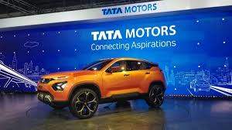
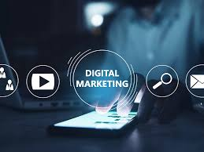
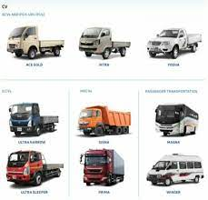
DIGITAL MARKETING OF TATA MOTORS

Slide 4
BRAND STUDY,COMPETITOR ANALYSIS & BUYERS / AUDIECNES PERSONA TATA MOTORS
1. Brand Study: This involves analyzing Tata Motors' brand identity, values, positioning, messaging, and overall perception in the market. It includes understanding what sets Tata Motors apart from its competitors, its strengths, weaknesses, opportunities, and threats. 2. Competitor Analysis: This involves studying Tata Motors' competitors in the automotive industry. Key competitors might include other Indian automakers like Mahindra & Mahindra, Maruti Suzuki, and global players like Toyota, Volkswagen, and Ford. The analysis would focus on their product offerings, market share, pricing strategies, marketing tactics, strengths, weaknesses, and any unique selling points. 3. Buyer/Audience Persona: This involves creating detailed profiles of Tata Motors' target customers or audience segments. This includes demographic information (age, gender, income, location), psychographic traits (lifestyle, values, attitudes), behavior (purchase habits, decision-making factors), needs, pain points, motivations, and goals. Here's a simplified breakdown of each step:

Slide 5
1. Research brand identity Tata Motors
Tata Passenger Electric Mobility, a subsidiary of Tata Motors and the pioneer
of India’s EV revolution today launched its new brand identity, TATA.ev, for the
EV business. This new identity is aligned to Tata Motors'
commitment on sustainability & pioneering innovation as well
as Tata Group's focus towards community development. The new brand identity embodies the core philosophy of “Move
with Meaning,” unifying the values of sustainability,
community, and technology. Commenting on the new brand identity,
Mr. Vivek Srivatsa, Head, Marketing, Sales and Service Strategy, Tata
Passenger Electric Mobility Ltd. said, “We are entering a new era with
TATA.ev. Our new brand identity for electric vehicles underlines our
commitment to accelerate the adoption of clean energy mobility solutions. We
intend to drive positive change in the automotive industry with the focus on
sustainability, community, and technology. Both the products and services are
intended to create highly differentiated and meaningful consumer
experiences. The brand personality is humane, honest, invigorating, and
conversational – a rallying point for those curious about having a better impact
on the world.

Slide 6
2. Competitor analysis
Tata Motors is a major car and truck maker globally. It owns Jaguar Land Rover, Tata Daewoo and Tata Marcopolo brands. In India, it competes with Maruti Suzuki, Hyundai and Mahindra. Globally, automakers like GM, Volkswagen and Toyota are its competitors. Tesla, which has established dominance in the electric-vehicles space, is also a challenger.
Geographical presence
Tata Motors has three major units. Its India-based car and trucks
business. Jaguar Land Rover (JLR), which it acquired in 2008. And
Tata Daewoo in South Korea. The latter makes commercial
vehicles. The company, by way of its subsidiaries and Joint Ventures, is present in India, the UK, South Korea, South Africa, China, Brazil, Austria and Slovakia. Besides, it sells its products in over 125 countries. Most of its global sales come from Jaguar Land Rover, which contributes 78% of the total revenue. JLR’s competitor
Toyota, which also owns the Lexus brand, is a global leader in the auto business. It is virtually present in every major country in the world. Its cars are famous for their durability and utility. Volkswagen, another global leader, owns Audi, Skoda, Bugatti, Bentley, Porsche and Lamborghini brands. General Motors, though based in Detroit,
is present in all habitable continents. The company sells its cars under Chevrolet, Buick, and Cadillac brands.

Slide 7
Financials
Tata Motors acquired JLR when the storied brand was struggling and produced a remarkable turnaround in its fortunes. From March 2009 to March 2015, the company's revenues grew from $5.77 billion to $42.5 billion. This happened as JLR won back market share in the US and got rapid success in China. But since then, the
ride became tough. JLR's market share peaked out in the US and China. Its production facilities in the UK were hampered by strikes and uncertainty because of Brexit. JLR’s sales have fallen from 500,000 in FY19 to 350,000 in FY21. This does not include its sales in China, which comes under the joint venture with Cherry. Tata Motors sales for FY21 stood at 840,000.In comparison, Volkswagen Group sold 9.16 million vehicles in the last fiscal. General Motors rolled out nearly 7 million new units on roads. Toyota said it has sold nearly 9 million vehicles across the globe. In terms of profits, Toyota clocked $21 billion on revenue of $257 billion. Volkswagen was the second most profitable auto company in the last fiscal year with a net at $10 billion on revenue of $254 billion. General Motors clocked $6 billion profit on sales of $122 billion. Tata Motor’s recorded a loss of $1.8 billion on sales of $34 billion.]
Future readiness
When Elon Musk, Founder of Tesla, said he will make only electric cars, few took notice. But today, Tesla is the most valued auto company, even though it sells a fraction of cars sold by Toyota, the world's biggest company. Electric vehicle adoption is the biggest challenge, and opportunity for the auto industry today. Tata Motors
and its competitors are dealing with this in their own way. Tata Motors already has a few electric models under its wings Its Nexon EV in India is already gaining market share. The company said it will launch 10 fresh battery-powered models by 2025.

Slide 8
Jaguar Land Rover also offers I-Pace as its all-electric model. Besides, the company offers many hybrid models. Jaguar Land Rover plans to achieve net-zero carbon emission by 2039. It is set to launch six new all-electric Land Rover models in the next five years. Jaguar will become a pure electric brand from 2025, its CEO said. Its competitors are also ramping up their electric plans. GM released
the Chevrolet Bolt EUV and revised Bolt EV earlier this year. Volkswagen has said it expects half of its car sales to come from EVs by 2030 and wants to become the leader in EVs. It has already prepared a platform on which its electric vehicles will be made, and unveiled an ambitious battery making plan. While Toyota has
invested heavily in battery and charging technologies, acquiring a number of startups in the space. The big three firms have also invested heavily in computing technologies, hiring a large number of software engineers. A short term challenge is the ongoing global chip shortage. Jaguar Land Rover, Tata Motors' cash cow, said the
issue will hit its production hard. But, this is something every automaker is dealing with. The industry believes the shortage will be over in the medium term. Change in environmental regulations in different countries can also derail its plans. A slowdown in
commercial vehicles sales is another area that the company needs to negotiate well.
Stock performance and valuations
Tata Motors has been gaining market share in the Indian passenger vehicle segment. It is now the third-largest carmaker with 8.2% of the sales pie. This compares to 4.6% in 2016, and 4.8% in 2020.Consequently, Tata Motors shares have gone up by nearly 5 times since bottoming out in April 2020. Lately, there has been some selling due to chip shortage and related production cuts. In comparison, shares of Toyota, Volkswagen and General Motors have gained 50-100 per cent in the same period.

Slide 9
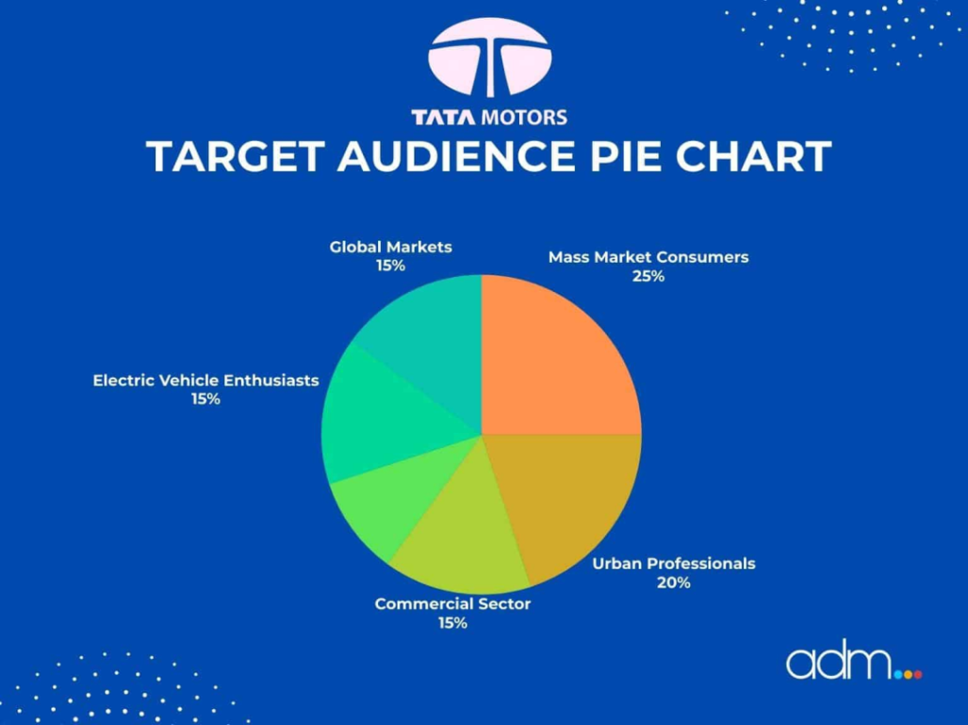
3. Buyer's/ Audience persona
Tata Motors is a car company in India that sells different types of cars to different types of people.
Their “target audience” refers to the specific group of people whom they are trying to sell their cars to. This group of people is who they believe are most likely to be interested in and buy their cars.
For example, suppose Tata Motors is selling a small car that is affordable and good for city driving. In that case, their target audience might be young people who are just starting out and looking for an affordable car to get around in.
On the other hand, if Tata Motors is selling a luxury SUV, its target audience might be wealthy individuals or families who want a comfortable and spacious vehicle for long drives.
Tata Motors tries to understand the needs and preferences of its target audience so that they can design and market their cars in a way that appeals to them. This helps them sell more cars and be successful as a business.

Slide 10
SWOT STRENGTHS TATA MOTORS
Brand Portfolio: Tata Motors has a diverse portfolio of brands under its umbrella, including Jaguar Land Rover (JLR) and Tata itself, which allows it to cater to different market segments and demographics.
Global Presence: Tata Motors has a strong global presence with operations in various countries. The acquisition of JLR has significantly enhanced its international footprint, providing access to established markets like the UK and the US.
Innovative Products: The company has been focusing on innovation and technological advancements in its products, especially in the electric and hybrid vehicle segment. Initiatives like the Tata Nexon EV and plans for future electric vehicle offerings showcase its commitment to sustainability and innovation.

Slide 11
SWOT OPPORTUNITIES TATA MOTORS
Electric Vehicle Market Growth: With the increasing demand for electric vehicles (EVs) globally, Tata Motors has the opportunity to expand its EV lineup and capture a larger market share in this growing segment.
Emerging Markets: Tata Motors can capitalize on emerging markets, especially in Asia, Africa, and Latin America, where there is a rising middle class and increasing demand for automobiles.
Strategic Partnerships: Collaborating with technology companies or other automotive manufacturers can help Tata Motors access new technologies, expand its product offerings, and enter new markets more effectively.
. Expansion into New Segments: Diversifying its product portfolio by entering new vehicle segments such as SUVs, luxury cars, or commercial vehicles can help Tata Motors capture additional market share and cater to different customer segments.
Government Incentives and Policies: Government incentives and policies aimed at promoting clean energy and sustainable transportation can create favorable conditions for Tata Motors to invest in and promote its electric and hybrid vehicles.

Slide 12
DECONSTRUCT TATA MOTORS
History and Background: Tata Motors is a part of the Tata Group, one of India's oldest and largest conglomerates. It was established in 1945 as Tata Engineering and Locomotive Co. Ltd. (TELCO). The company's primary focus initially was on manufacturing locomotives and other engineering products.
Automobile Division: Tata Motors is primarily known for its automobile division, which manufactures a wide range of vehicles including passenger cars, trucks, vans, buses, and military vehicles. It has a significant presence in both domestic and international markets.
Brands and Products: Tata Motors owns several brands under which it sells its vehicles. These include Tata, Jaguar, and Land Rover. The Tata brand encompasses a range of affordable passenger cars, utility vehicles, and commercial vehicles, while Jaguar Land Rover (JLR) represents the luxury segment.
Global Presence: Tata Motors has a global presence with operations in various countries across the world. It has manufacturing facilities in India, the United Kingdom, South Africa, and other locations. The acquisition of Jaguar Land Rover in 2008 significantly expanded its international footprint.

Slide 13
WEAKNESSES TATA MOTORS
Brand Perception: While Tata Motors is a well-established brand, especially in India, it might not enjoy the same level of brand perception and trust as some of its international competitors. This could affect its ability to attract premium customers in certain markets.
Quality Concerns: In the past, Tata Motors has faced criticism regarding the quality of its vehicles, particularly in terms of fit and finish, and reliability. Addressing these concerns is crucial to maintain customer satisfaction and compete effectively in global markets.
Dependence on Specific Markets: Tata Motors heavily relies on the Indian market for a significant portion of its revenue. While India is a large and growing market, overdependence on it exposes the company to risks associated with economic fluctuations, regulatory changes, and intense competition.
Product Portfolio Gaps: Tata Motors' product portfolio might have gaps in certain segments or regions, limiting its ability to cater to diverse customer needs effectively. Addressing these gaps through product innovation or strategic partnerships is essential for sustained growth.

Slide 14
THREATS TATA MOTORS
It seems like you're asking about threats to Bioderma India posed by Tata Motors. It's important to note that Bioderma India and Tata Motors operate in different industries, with Bioderma focusing on skincare products and Tata Motors primarily manufacturing automobiles. However, if you're looking for potential challenges or competition within the Indian market, it could include factors like changes in consumer preferences, regulatory hurdles, economic fluctuations, or competition from other skincare brands for Bioderma India, while Tata Motors might face challenges like shifts in automotive technology, market demand, regulatory changes, and competition from both domestic and international automobile manufacturers. Each company would have its own unique set of challenges and opportunities within their respective industries.

Slide 15
DECONSTRUCT STRENGTH WEAKNESS TATA MOTORS
Diverse Portfolio: Tata Motors has a broad product portfolio ranging from small passenger cars to heavy commercial vehicles. This diversity helps the company to cater to various market segments and adapt to changing consumer preferences.
Global Presence: Tata Motors has a significant global footprint with operations in various countries across Asia, Europe, Africa, and South America. This global presence not only
WEAKNESS TATA MOTORS
Product Quality Concerns: Tata Motors has faced criticism regarding the quality of some of its vehicles, particularly in terms of fit and finish, as well as reliability. Issues with durability or performance can undermine consumer confidence and affect brand perception negatively.
Brand Perception: While Tata Motors has made efforts to improve its brand image, especially with the acquisition of Jaguar Land Rover, there still exists a perception in some markets that Tata vehicles are inferior in quality compared to competitors. This perception can impact sales and market share.

Slide 16
DECONSTRUCT OPPORTUNITIES & THREATS TATA MOTORS
OPPORTUNITIES TATA MOTORS
Market Analysis: Understanding market trends, such as the shift towards electric vehicles (EVs), autonomous driving technology, and changing consumer preferences for sustainable and technologically advanced vehicles.
Competitive Landscape: Assessing the strengths and weaknesses of competitors like Maruti Suzuki, Hyundai, and Mahindra & Mahindra, especially in areas like product innovation, market share, and distribution networks.
THREATS TATA MOTORS
As of my last update in January 2022, I don't have access to real-time information or news. However, discussing threats to Tata Motors generally involves considering factors like competition in the automotive industry, economic fluctuations affecting consumer spending, technological disruptions, regulatory changes, and geopolitical tensions affecting supply chains or markets.
Would you like an analysis of potential threats based on those factors? Or is there a specific aspect of Tata Motors' operations you're concerned about?

Slide 17
MY WISHCARE STRENGTH & WEAKNESS TATA MOTORS
It sounds like you're expressing a desire for Tata Motors to have strength in its operations or
perhaps you're referring to the performance of Tata Motors' stock (TAMO) on the stock market.
Tata Motors is a significant player in the automotive industry, known for its wide range of vehicles
from cars to commercial vehicles. Strengthening in this context could involve various aspects like
improving market share, enhancing product quality, expanding into new markets, or increasing
profitability. If you have a specific area in mind, I can provide more tailored information or advice.
By

Slide 18
MY WISHCARE OPPORTUNITIES & THREATS TATA MOTORS
Company Website: Visit Tata Motors' official website and navigate to their careers section. Look for job openings related to customer service, customer experience, or innovation.
Job Portals: Check popular job portals where Tata Motors posts their job openings. You can use keywords like "wishcare" "customer satisfaction," or "customer service" along with "Tata Motors" to refine your search.
LinkedIn: Utilize LinkedIn to connect with professionals working at Tata Motors. Networking can provide insights into available opportunities and even help in getting referrals.
Professional Networking Events: Attend industry events, seminars, or conferences where Tata Motors representatives might be present. Networking in person can sometimes lead to valuable opportunities.
THREATS TATA MOTORS
It seems like you're talking about "Wishcare" which might be a service or product provided by Tata Motors. If you're facing threats related to this service, it's essential to address them appropriately. Could you provide more details about the specific threats you're encountering? That way, I can offer more targeted advice or information. By

Slide 19
SEO & KEYWORD RESEARCH TATA MOTORS
Understand the Business: Begin by understanding Tata Motors' products, services, and target market. This will help you tailor your keyword research to topics relevant to their offerings.
Brainstorm Seed Keywords: Generate a list of seed keywords related to Tata Motors, including their vehicle models, services, and industry terms. For example:
● Tata Motors
● Tata passenger vehicles
● Tata commercial vehicles
● Tata SUVs
● Tata electric vehicles
● Tata dealership
● Tata vehicle maintenance
Competitor Analysis: Look at what keywords competitors are targeting. Tools like SEMrush or Ahrefs can help identify keywords that competitors are ranking for.
Long-tail Keywords: Identify long-tail keywords that are specific and have lower competition. These often have higher conversion rates. For example:
● "Best Tata electric vehicle in India"
● "Tata Motors dealership near me"
● "Tata SUV safety features“
● "Tata commercial vehicles for sale"
Keyword Research Tools: Utilize keyword research tools like Google Keyword Planner, Ubersuggest, or Moz Keyword Explorer to expand your list and find relevant keywords with search volume data.

Slide 20


SEO AUDIT TATA MOTORS

Slide 21
ON PAGE OPTIMIZATION TATA MOTORS
Keyword Research: Identify relevant keywords related to Tata Motors, its products, and services. Use tools like Google Keyword Planner or SEMrush to find keywords with high search volume and low competition.
Title Tag Optimization: Craft unique and compelling title tags for each webpage, including relevant keywords and the Tata Motors brand name. Keep the title tag under 60 characters to ensure it displays properly in search results.
Meta Description: Write informative meta descriptions that accurately summarize the content of each webpage. Include relevant keywords and encourage clicks by making the description engaging and persuasive.
Heading Tags (H1, H2, etc.): Use heading tags to structure the content logically and make it easier for both users and search engines to understand. Include target keywords in your headings where appropriate.
Content Optimization: Create high-quality, relevant content that provides value to users. Incorporate target keywords naturally throughout the content, but avoid keyword stuffing. Ensure that the content is well-organized, easy to read, and includes multimedia elements like images and videos where applicable

Slide 22
ON PAGE OPTIMIZATION (CONTENT OPTIMIZATION ) TATA MOTORS
Keyword Research: Identify relevant keywords related to Tata Motors, its products, services, and industry. Tools like Google Keyword Planner, SEMrush, or Ahrefs can help you find keywords with high search volume and low competition.
Content Creation: Develop high-quality, informative content that incorporates the identified keywords naturally. This content could include product descriptions, blog posts, landing pages, FAQs, etc. Ensure that the content is valuable to the audience and provides solutions to their queries.
Title Tags: Optimize title tags by including primary keywords and ensuring they are descriptive and compelling. Keep them under 60 characters to ensure they display properly in search engine results.
Meta Descriptions: Write compelling meta descriptions that accurately summarize the content of the page and encourage users to click through to the website. Include relevant keywords but avoid keyword stuffing.

Slide 23
Content idea generation and strategy
Developing content ideas and strategies for Tata Motors involves understanding their target audience, brand values, and industry trends. Here’s a step-by-step guide:
Understand Audience Persona: Identify the target demographic for Tata Motors. This could include individuals interested in automobiles, businesses looking for commercial vehicles, and investors interested in the automotive industry.
Research Industry Trends: Stay updated on the latest trends in the automotive industry, such as electric vehicles, autonomous driving technology, sustainability initiatives, and changes in consumer preferences.
Highlight Brand Values: Tata Motors has a strong focus on innovation, sustainability, and social responsibility. Develop content that aligns with these values, showcasing the company's efforts in these areas.
Content Calendar: Plan a content calendar based on important dates, events, product launches, and industry milestones. Ensure consistency in posting across various platforms.
SEO Optimization: Optimize content for search engines by using relevant keywords related to Tata Motors, automobiles, and related topics.

Slide 24

Content Ideas:
● Product Features and Reviews: Highlight key features of Tata Motors vehicles, including performance, safety, and technology.
● Behind-the-Scenes: Take audiences behind the scenes to show the manufacturing process, research and development efforts, and the people behind Tata Motors’ success.
● Customer Stories/Testimonials: Share stories of satisfied customers or businesses who have benefited from using Tata Motors vehicles.
● Educational Content: Create content that educates audiences about automotive industry trends, vehicle maintenance tips, or sustainable driving practices.
● Community Engagement: Engage with the audience through contests, challenges, or user-generated content campaigns.
● Corporate Social Responsibility (CSR): Highlight Tata Motors’ CSR initiatives, such as environmental conservation efforts or community development projects. ● Thought Leadership: Publish articles or whitepapers authored by Tata Motors’ executives or

Slide 25
MARKETING STRATEGIES TATA MOTORS
Tata Motors is a company that uses digital marketing strategies to promote its products and reach new customers. Here are some of the digital marketing strategies they use:
Social Media Marketing: Tata Motors uses social media platforms like Facebook, Instagram, and Twitter to promote its products and engage with customers. They share images and videos of their vehicles and also run social media campaigns to attract new customers.
Search Engine Optimization (SEO): Tata Motors makes sure that its website appears at the top of search engine results when people search for keywords related to their products. This is done through various SEO techniques like optimizing website content and building backlinks.
Pay-Per-Click (PPC) Advertising: Tata Motors uses PPC advertising to target customers who are searching for information related to their products. They place ads on search engine result pages and pay only when someone clicks on the ad.
Content Marketing: Tata Motors creates engaging and informative content related to its products, such as videos, blog posts, and info graphics. This helps to build brand awareness and establish their authority in the industry.
Email Marketing: Tata Motors sends promotional emails to customers who have subscribed to their newsletter. They use email marketing to announce new products, special offers, and other important news related to their brand.
These are just a few of the digital marketing strategies that Tata Motors uses to promote its products and reach new customers. By using a combination of these strategies, they can create a strong online presence and drive sales for their business.

Slide 26
Tata Motors, as a prominent player in the automotive industry, employs various marketing strategies to reach its target audience, promote its products, and strengthen its brand presence. Here are some key marketing strategies Tata Motors may employ:
Segmentation and Targeting: Tata Motors likely segments its market based on factors such as demographics, psychographics, and behavior to identify specific customer groups. By understanding the needs and preferences of these segments, Tata Motors can tailor its marketing efforts more effectively.
Product Differentiation: Tata Motors differentiates its products from competitors by highlighting unique features, such as safety innovations, fuel efficiency, technology integration, and design aesthetics. This helps the company stand out in a crowded market.
Brand Building: Tata Motors invests in building a strong brand image by emphasizing its core values of innovation, reliability, sustainability, and social responsibility. Marketing campaigns often focus on storytelling to connect emotionally with consumers and showcase the company's commitment to excellence.
Promotion Strategy: Use social media, email newsletters, influencer partnerships, and paid advertising to promote Tata Motors’ content and reach a wider audience.
.Measure and Analyze: Track the performance of content using analytics tools to understand what resonates with the audience and refine future content strategies accordingly.
Iterate and Improve: Continuously evaluate the effectiveness of content and refine the strategy based on feedback and performance metrics.

Slide 27
Sponsorships and Partnerships: Tata Motors may engage in strategic partnerships and sponsorships with events, sports teams, or cultural organizations to increase brand visibility and reach a wider audience. These collaborations help reinforce brand associations and enhance brand perception.
Market Expansion: Tata Motors may pursue market expansion strategies by entering new geographical markets or introducing new product lines to cater to evolving customer needs and preferences. This could involve conducting market research, adapting products to local tastes, and establishing distribution networks.
Corporate Social Responsibility (CSR): Tata
Integrated Marketing Communications (IMC): Tata Motors employs a mix of traditional and digital marketing channels to reach consumers at various touch points. This includes advertising through television, print media, outdoor billboards, online platforms, social media, and experiential marketing events.
Digital Marketing: In the digital age, Tata Motors leverages digital marketing strategies such as search engine optimization (SEO), pay-per-click (PPC) advertising, content marketing, social media marketing, email marketing, and influencer partnerships to engage with consumers, generate leads, and drive sales.
Customer Relationship Management (CRM): Tata Motors focuses on building and maintaining strong relationships with customers through CRM initiatives. This includes personalized communication, loyalty programs, after-sales services, and gathering feedback to continuously improve the customer experience.

Slide 28
CONTENT CREATION & CURATION
POST CREATION
Creating and curating content for Tata Motors involves understanding their target audience, industry trends, and brand values. Here’s a strategy for content creation and currection:
Audience Research: Identify the target audience for Tata Motors, including individual consumers, businesses, and investors. Understand their demographics, preferences, pain points, and interests related to automobiles.
Industry Trends: Stay updated on the latest trends in the automotive industry, such as electric vehicles, autonomous driving technology, sustainability initiatives, and changing consumer preferences.
Brand Values: Highlight Tata Motors’ brand values of innovation, reliability, sustainability, and social responsibility in content creation. Ensure that all content aligns with these values and reinforces the brand identity.
Content Types: Create a diverse range of content types to cater to different audience preferences and consumption habits. This could include:
● Product Features and Reviews: Highlight key features of Tata Motors vehicles, including performance, safety, and technology.
● Behind-the-Scenes: Showcase the manufacturing process, research, and development efforts, and the people behind Tata Motors’ success.
● Customer Stories/Testimonials: Share stories of satisfied customers or businesses who have benefited from using Tata Motors vehicles.
● Educational Content: Provide informative content about automotive industry trends, vehicle maintenance tips, or sustainable driving practices.
● Community Engagement: Engage with the audience through contests,

Slide 29
challenges, or user-generated content campaigns.
● Corporate Social Responsibility (CSR): Highlight Tata Motors’ CSR initiatives, such as environmental conservation efforts or community development projects.
● Thought Leadership: Publish articles or whitepapers authored by Tata Motors’ executives or experts, discussing industry insights, future trends, or technological innovations.
Content Types: Create a diverse range of content types to cater to different audience preferences and consumption habits. This could include:
● Product Features and Reviews: Highlight key features of Tata Motors vehicles, including performance, safety, and technology.
● Behind-the-Scenes: Showcase the manufacturing process, research, and development efforts, and the people behind Tata Motors’ success.
● Customer Stories/Testimonials: Share stories of satisfied customers or businesses who have benefited from using Tata Motors vehicles.
● Educational Content: Provide informative content about automotive industry trends, vehicle maintenance tips, or sustainable driving practices.
● Community Engagement: Engage with the audience through contests, challenges, or user-generated content campaigns.
● Corporate Social Responsibility (CSR): Highlight Tata Motors’ CSR initiatives, such as environmental conservation efforts or community development projects.
● Thought Leadership: Publish articles or whitepapers authored by Tata Motors’ executives or experts, discussing industry insights, future trends, or technological innovations.

Slide 30
INSTAGRAM STORY
Analytics and Measurement: Track the performance of content using analytics tools to measure metrics such as website traffic, engagement, social shares, lead generation, and conversion rates. Use insights to iterate and improve content strategies over time.
By following these steps, Tata Motors can effectively create and curate content that resonates with its target audience, strengthens its brand presence, and drives engagement and loyalty among consumers.
You
INSTA STORY
ChatGPT
Creating an engaging Instagram Story for Tata Motors could involve showcasing their latest vehicle models, highlighting key features, or sharing behind-the-scenes glimpses of their manufacturing process. Here's a creative idea for an Instagram Story:
Frame 1: Introduction
● Start with a captivating image or video of a sleek Tata Motors vehicle against an impressive backdrop.
● Add text: "Welcome to the world of Tata Motors. Explore our latest innovations!

Slide 31
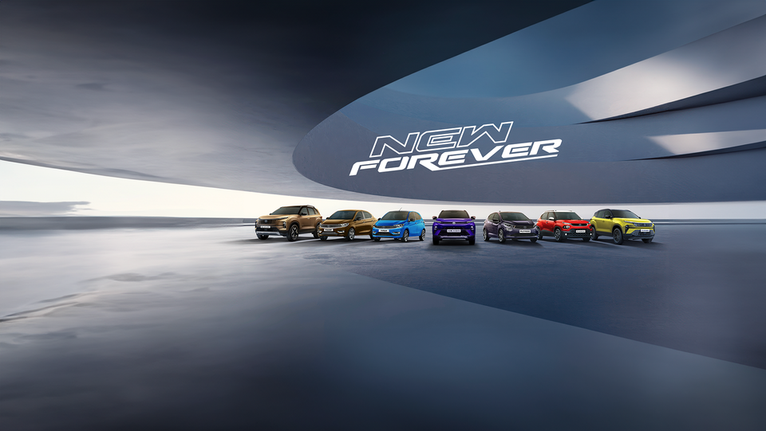
FACEBOOK REEL OF TATA MOTORS
https://www.facebook.com/reel/251836891307585/?s=fb_shorts_tab&stack_idx=0

Slide 32

HIGHLIGHTS OF THE STORY
EV charging is now more convenient than refueling! Charge at home or at any public charger enroot. You are never far from one as 10,000+ public chargers are easily accessible across cities, towns and highways. With charging infra growing exponentially, easy will only get easier!
Take a deep dive into this evolving seamlessness in EV charging with mentor Balaje Rajan.
http://cars.tatamotors.com/

Slide 33
DESIGNS/ VIDEO EDITINGS
If you're looking for Tata Motors designs for editing purposes, there are several options depending on what you're aiming for:
Official Press Material: Tata Motors often releases high-quality images of their vehicles for promotional purposes. You can find these images on their official website or through press releases. These images are usually well-lit and showcase the vehicles from various angles, making them ideal for editing.
Stock Photo Websites: Websites like Shutterstock, Getty Images, and Adobe Stock may have a variety of Tata Motors vehicle images available for purchase or free download. These images are professionally shot and edited, providing a good starting point for your editing projects.
Social Media and Fan Communities: Explore social media platforms like Instagram, where enthusiasts and photographers often share their photos of Tata Motors vehicles. You can find a wide range of images, including close-ups, action shots, and creative edits. Just be sure to respect copyright and give credit to the original creators if you plan to use their work.
.Feedback: Provide immediate and informative feedback to users when they make edits, confirming actions, and highlighting any errors or issues that need attention.
Flexibility: Offer a range of editing options and features to accommodate different user preferences and editing styles, allowing for customization and flexibility.
Accessibility: Ensure that the editing interface is accessible to all users, including those with disabilities, by incorporating features like keyboard shortcuts, screen reader compatibility, and adjustable text sizes.
Efficiency: Optimize the editing process for speed and efficiency, with tools and shortcuts that enable users to quickly make edits and adjustments

Slide 34
VIDEO EDITING TECHNIQUES
Tata Motors, being a prominent automotive company, would likely use various video editing techniques to create compelling content for its audience. Here are some common techniques they might employ:
Storyboarding: Before diving into the editing process, Tata Motors would likely create a storyboard to plan out the sequence of shots and overall narrative flow of the video.
Cinematic Shots: Tata Motors might use cinematic shots such as wide establishing shots, close-ups of details, and dynamic angles to showcase their vehicles in an engaging and visually appealing way.
Motion Graphics: Incorporating motion graphics can add a modern and dynamic element to their videos. They might use graphics to highlight key features of their vehicles or to display technical specifications.
Drone Footage: Aerial shots captured by drones can provide unique perspectives and stunning visuals of Tata Motors' vehicles in various environments, such as driving through scenic landscapes or navigating urban streets. effects can greatly enhance the mood and atmosphere of their videos.
Tata Motors might use upbeat music for promotional videos or immersive sound design to highlight the performance of their vehicles.
Color Grading: Color grading is essential for maintaining a consistent visual style across different shots and creating a mood that aligns with Tata Motors' brand identity. They might opt for vibrant colors to convey energy and excitement or a more subdued palette for a sophisticated look.
Transitions: Smooth transitions between shots can help maintain the flow of the video and keep viewers engaged Tata.

Slide 35
INSTAGRAM REEL TATA MOTORS
Tata Motors (@tatamotorsgroup)
Instagram
https://www.instagram.com › tatamotorsgroup
Tatamotorsgroup
At Tata Motors, design isn't just a feature; it's our essence. Our vehicles embody a legacy of aesthetic excellence and functional brilliance. From sleek lines to ergonomic interiors, every design decision reflects our commitment to innovation and elegance. Check out this video on our YouTube channel to dive deeper into our world at Tata Motors. Join us to discover how we're shaping the future of mobility with design in our DNA by clicking the link in the bio. https://www.instagram.com/tatamotorsgroup/reel/C6Ai0ewo6iC/

Slide 36
Objective:
To showcase Tata Motors' commitment to innovation, sustainability, and social responsibility while promoting its latest lineup of electric and eco-friendly vehicles.
Target Audience:
● Environmentally conscious consumers
● Urban commuters
● Tech-savvy individuals
● Millennials and Gen Z
Platforms:
● Facebook
● Instagram
● Twitter
● LinkedIn
Campaign Elements:
Teaser Videos: Short, captivating videos teasing the launch of Tata's new electric vehicle lineup, highlighting features like eco-friendly design, advanced technology, and sleek aesthetics.
Interactive Polls: Engage the audience with interactive polls on Twitter and Instagram Stories, asking questions related to sustainability, electric vehicles, and environmental impact.
Behind-the-Scenes Content: Share behind-the-scenes glimpses of Tata Motors' manufacturing facilities, research labs, and design studios, showcasing the company's dedication to innovation and quality

Slide 37
User-Generated Content Contest: Encourage users to share their experiences with Tata vehicles or their ideas for a sustainable future using a branded hashtag. Offer prizes for the most creative or impactful submissions.
Influencer Partnerships: Collaborate with eco-conscious influencers and environmental activists to promote Tata's electric vehicles and sustainability initiatives to their followers.
Live Q&A Sessions: Host live Q&A sessions on Facebook or Instagram, featuring Tata Motors' experts discussing topics like electric vehicle technology, charging infrastructure, and the future of sustainable transportation.
Interactive Car Configurator: Launch an interactive car configurator tool on the Tata Motors website and promote it through social media, allowing users to customize their dream electric vehicle and share their designs with friends.
EMAIL AD CAMPAIGNS
At Tata Motors, we're driven by innovation and dedicated to bringing you vehicles that redefine excellence on the road. We're thrilled to introduce you to our latest lineup of cutting-edge models, designed to elevate your driving experience to new heights. Whether you're seeking efficiency, performance, or luxury, we have the perfect vehicle to suit your needs. From sleek sedans to robust SUVs, our range offers something for every driver.
Here's a glimpse of what awaits you:
Tata Nexon EV: Experience the future of mobility with our electric SUV, packed with advanced features and eco-friendly performance.
Tata Harrier: Command attention with its striking design and unmatched performance capabilities, making every journey a thrilling adventure.

Slide 38
But that's not all! When you choose Tata Motors, you also gain access to our exceptional service network, ensuring peace of mind throughout your ownership journey.
Ready to experience innovation like never before? Visit your nearest Tata Motors dealership today and test drive the future of driving.
Stay connected with Tata Motors on social media for the latest updates and exclusive offers.
Innovation awaits. Your journey starts here.
Warm regards,
[Your Name]
[Your Position]
Tata Motors

Slide 39

THANK YOU

